Slide 1


Voluntary Carbon Market:
FRA Strategic Approach

Slide 2

Introduction
Mitigation efforts, while having made some progress, have not been sufficient to avoid the significant impacts of climate change. Global greenhouse gas emissions continue to rise, and the world is already experiencing the consequences in the form of more frequent and intense extreme weather events, rising sea levels, and disruptions to ecosystems.
The United Nations Environment Programme (UNEP) estimates that annual adaptation costs in developing countries alone could reach $140-300 billion by 2030 and $280-500 billion by 2050.
2

Slide 3
Why Voluntary Carbon Markets?
Compensating for
GHG Emissions
Driving & Financing Transformation
Promoting Global Decarbonization Efforts
Supporting Transition To
A Low-carbon Future
Reducing Cost of Implementing Climate Commitments
3

Slide 4
How the VCM Works?
1
2
3
4
5
Carbon Reduction Project Planning
Project Design Document (PDD)
Validation of the PDD
Registering the Reduction Project
Project Execution
Project Developer
VVBs
Voluntary Carbon Registry
Project Developer
10
9
8
7
6
Carbon Offsetting
Trading and Settlement of the Carbon Credits
Issuance of the VCCs
Verification
MRV (Monitoring Verification and Reporting)
Demand Side (Buyer)
EGX and Taswyaat
Voluntary Carbon Registry
VVBs
Voluntary Carbon Registry
4

Slide 5
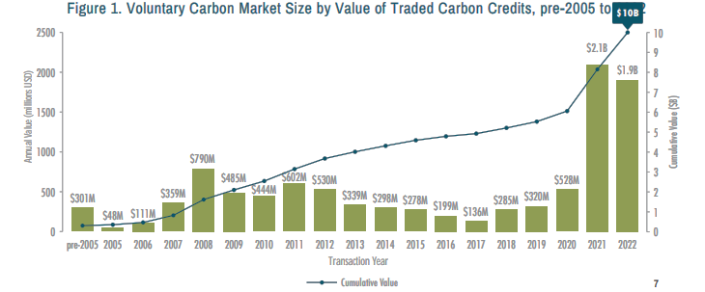
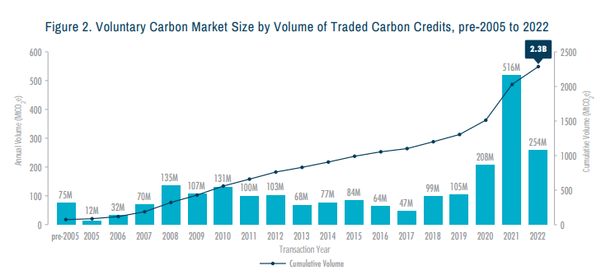





Global VCM Facts and Trends
Pre-2005
$301M
2022
$1.9B
Pre-2005
75M MtCO2e
2022
254M MtCO2e
Source: ECOSYSTEM MARKETPLACE INSIGHTS REPORT Paying for Quality State of the Voluntary Carbon Markets 2023 – November edition

Slide 6



Global VCM Facts and Trends
2022 Numbers for VCM
Issuances
(Supply)
Retirement
(Demand)
Pricing
≈25%
Above five year average
≈45%
Above five year average
Overall prices in 2022 are around 40% higher than in 2021, however, adjusted downwards at the end of the year
45.8 million carbon credits
issued in December 2022, the highest monthly issuances on record
≈3.4%
growth in demand in 2022 compared to 2021 (excluding activity related to crypto)
Community and nature-based solutions (NBS) removal projects have been the most resilient over 2022
Source: Publicly available data from Verra, Gold Standard (GS), American Carbon Registry (ACR) and Climate Action Reserve (CAR). Last observation: 31/12/2022.
Trove Research. (2023, January). Trove Research Webinar, 2022 VCM in review [Video].

Slide 7



Lunching Regulated VCM
During COP27 and with the increasing crucial role of sustainable finance in achieving the transition into low carbon economy, the Financial Regulatory Authority (FRA), Ministry of Environment (MoE), and The Egyptian Exchange (EGX) announced establishing Egypt as a regional hub for African voluntary carbon credit.
FRA has taken decisive action to build the voluntary carbon market structure, not only through regulations but also through building the market blocks and connecting different stakeholders as recognizing the power of balanced regulation to address fragmentation in the voluntary carbon markets worldwide.
7

Slide 8




VCM Regulatory Framework
1
2
3
Decree No.4664 of 2022
Amending Executive Regulations
Decree No.57 of 2023
VCM High-level committee
Decree No.163 of 2023
Requirements for VVBs
To defined carbon credits as financial instruments
EGX to Establish The VCM Exchange.
FRA to Establish high-level committee to oversight the VCM.
Committee composition ensures the involvement of MOE , EGX, Private Sector.
Committee's mandate is to ensure rigorous oversight and regulation, enhancing the credibility and integrity of Egypt's VCM .
International and local VVBs.
The requirements for the VVBs according to the international best practices include the accreditation on ISO-14065, ISO-17029,
Financial Instrument
Criteria for Approving (VVBs).
Criteria for Recognizing Voluntary Carbon Registries.
Listing and delisting Regulations
Guiding Rules For The Integrity and creditability in VCM.
8

Slide 9
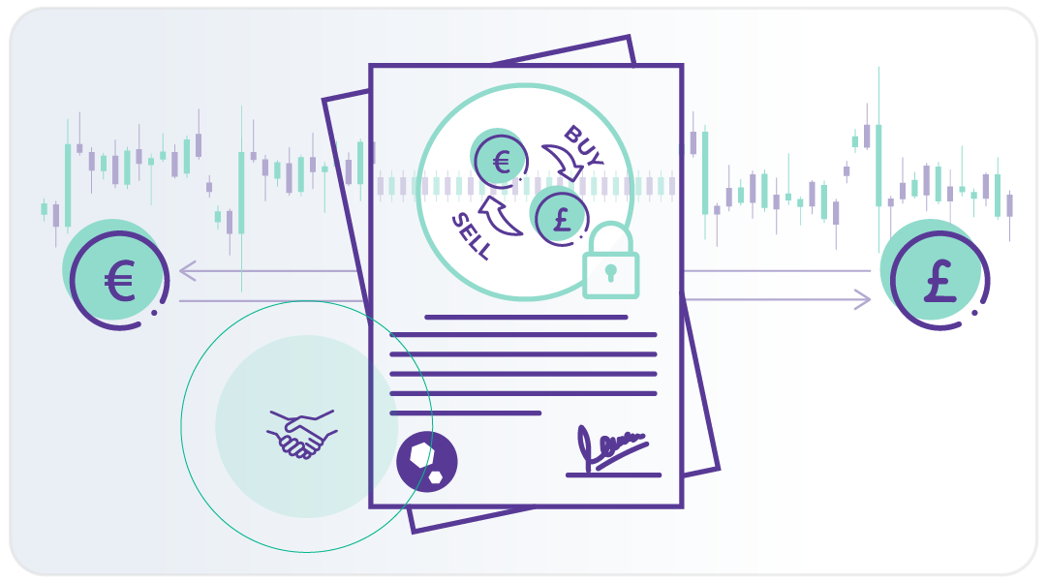


VCM Regulatory Framework
4
5
Decree No.30 of 2024
Approving Local Voluntary Carbon Registries
Decree No.31 of 2024
Listing and delisting rules
Requirements for the international voluntary carbon registries to be endorsed by the International Carbon Reduction and Offset Alliance (ICROA).
Emphasize on the governance requirement specially the ones related to the IT and cybersecurity elements to ensure the full integrity of the carbon registries and the resulted carbon credits.
Two international registries are communicating with the FRA:
  Bio Carbon Registry,
  EcoRegisrty
Requirements for registering the carbon reduction projects in the FRA's database and listing the carbon credits for trading in EGX.
Listing of forward contracts on voluntary carbon credits.
9

Slide 10
VCM Regulatory Framework
06
(Decree no. 636 of 2024) Accounting treatment for carbon credits in the accounting books.
FRA issued the official accounting treatment of the carbon credits that include four main cases:
  The case where the carbon credits are issued to the project developer (and being the owner of the reduction project too), thus the Carbon Credits are Intangible Asset in case that the credits will be used for offsetting and Financial Instrument if the credits are to be sold.
  The case where the carbon credits are issued to the project developer which is different entity of the one that owns the carbon emissions reduction project, in this case, the Carbon Credits are Financial Instrument.
  The case where the carbon credits are bought from the market to achieve the carbon neutrality (thus the CCs are Intangible Asset)
  The case where the carbon credits are bought from the market to be traded (thus the CCs are Financial Instrument).
10

Slide 11
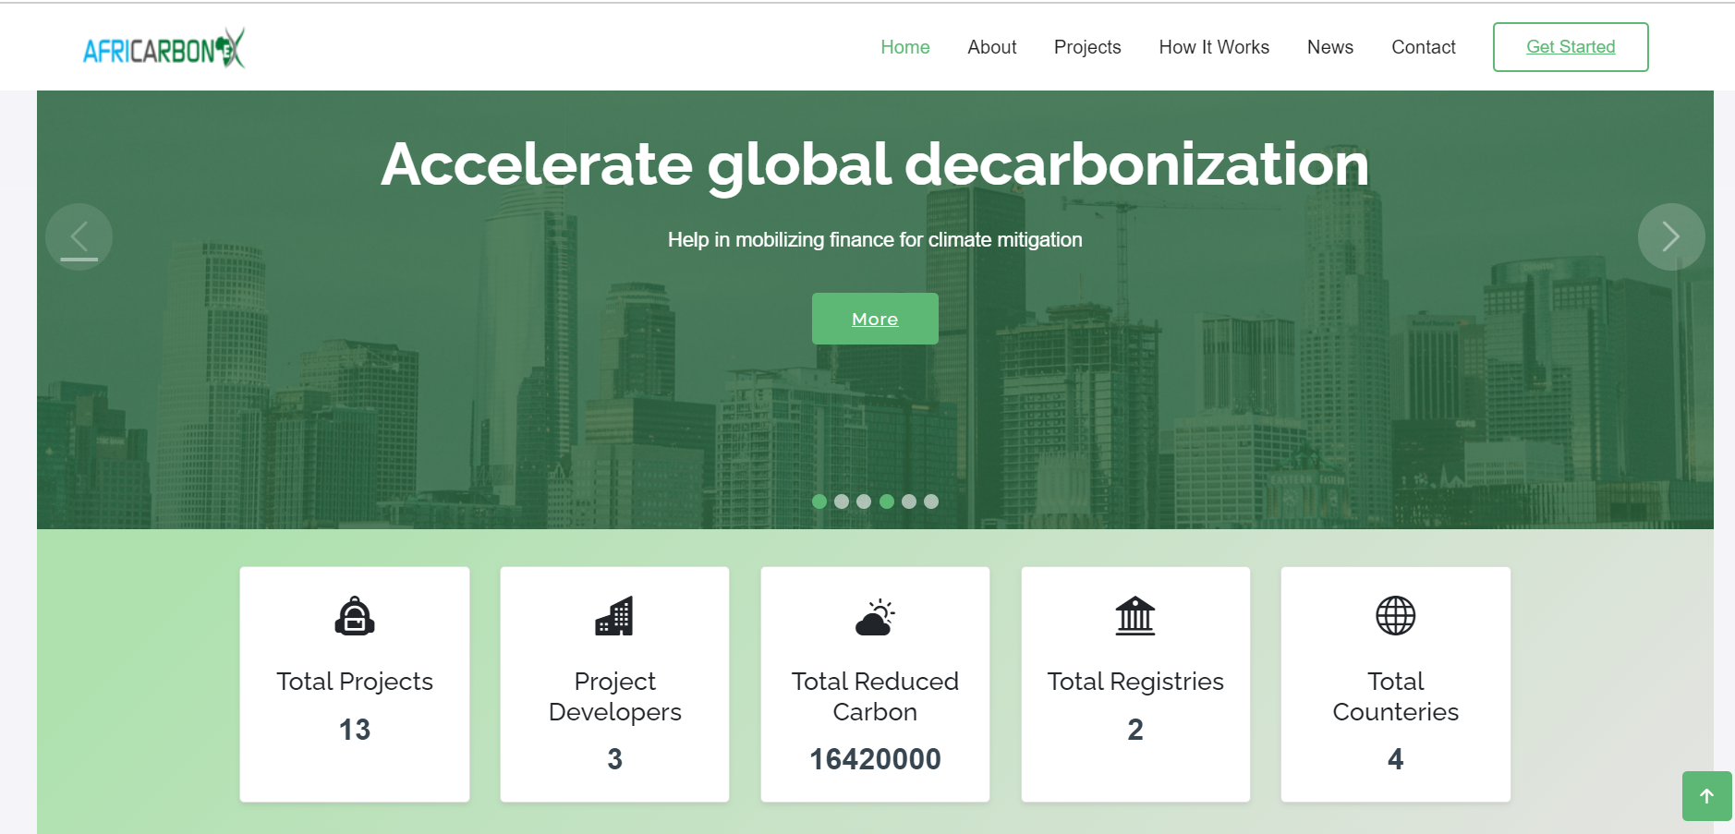

www.africarbonex.com

Slide 12
Thank you

